Slide 1
WEB 322 WEB PROGRAMMING TOOLS AND FRAMEWORKS
Week 11 – Lecture 1
Approaches to Loading Data

Slide 2

What’s the problem?
Your web app needs data before we can publicly deploy it to the user community.
In the past:
you populated a fake database (a static JavaScript object).
You have also created your own schemas and models for MongoDB and PostgreSQL.

Slide 3
An approach for your project
After defining a data store, you can programmatically add new objects.
We can code a special-purpose (or throw-away) controller with one or more routes that save objects into the MongoDB.
As the programmer, you can choose whether or “protect” the controller and its methods so only “clerks” can call the routes.
You can choose to keep or delete the controller after it has done its job.

Slide 4
Summary of the strategy
In summary, the strategy includes:
Creating a special-purpose “LoadData” controller.
Adding one or more routes that add programmatically-generated objects into the MongoDB.
Run the Express web app and type the URL into a browser.

Slide 5
How do we design a data loading solution?
You can programmatically add a few data items easily, but this method is not well suited for creating hundreds or thousands of objects.
To design a data loading solution, we must answer these fundamental questions (and maybe others):
Where is the source data?
What is the format of the source data?
Do we want the source data to be located within the project’s file system?

Slide 6

Where is the source data?
Answering this question and understanding its implications is very important.
In a file (in the file system)?
On the web?
In a database?

Slide 7
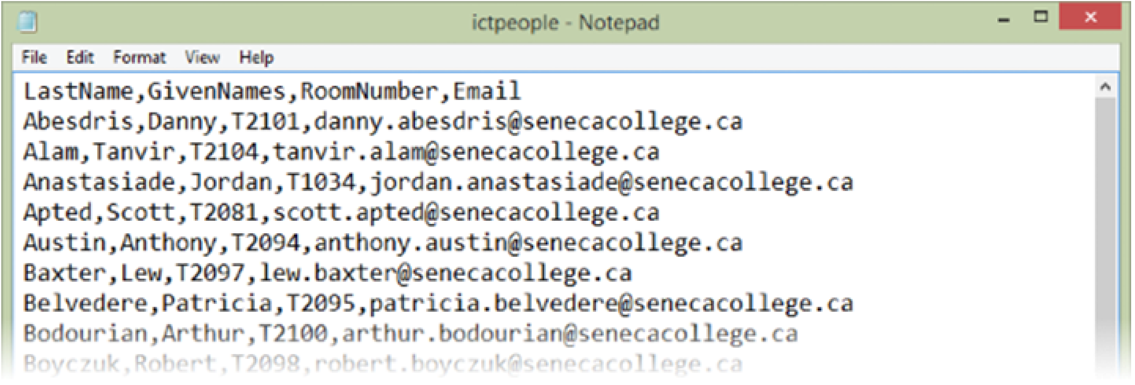
A comma-separated values (CSV) file?

Slide 8
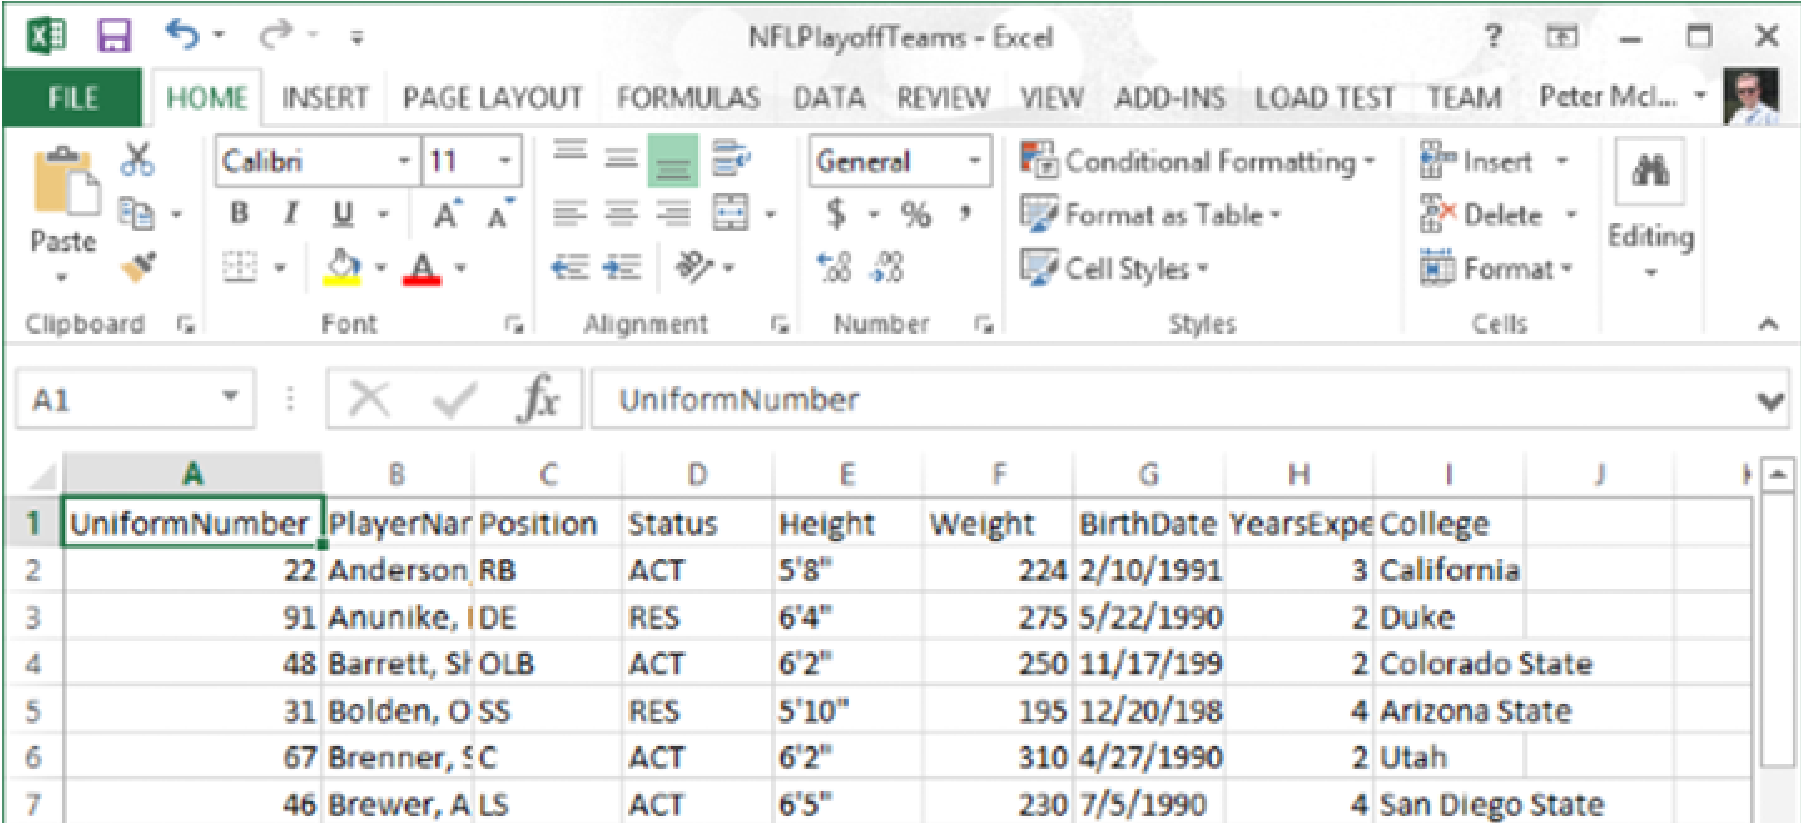
An Excel (XLSX) Workbook File?

Slide 9
Where is the source data?
Maybe the data is on the web… on a web page contained in an HTML table.
It can by manually extracted with a drag-and-drop “select” action, copied, and pasted to a destination.
Microsoft Excel can be a useful tool for this purpose, as it is nicely-equipped to receive pasted HTML table data.

Slide 10
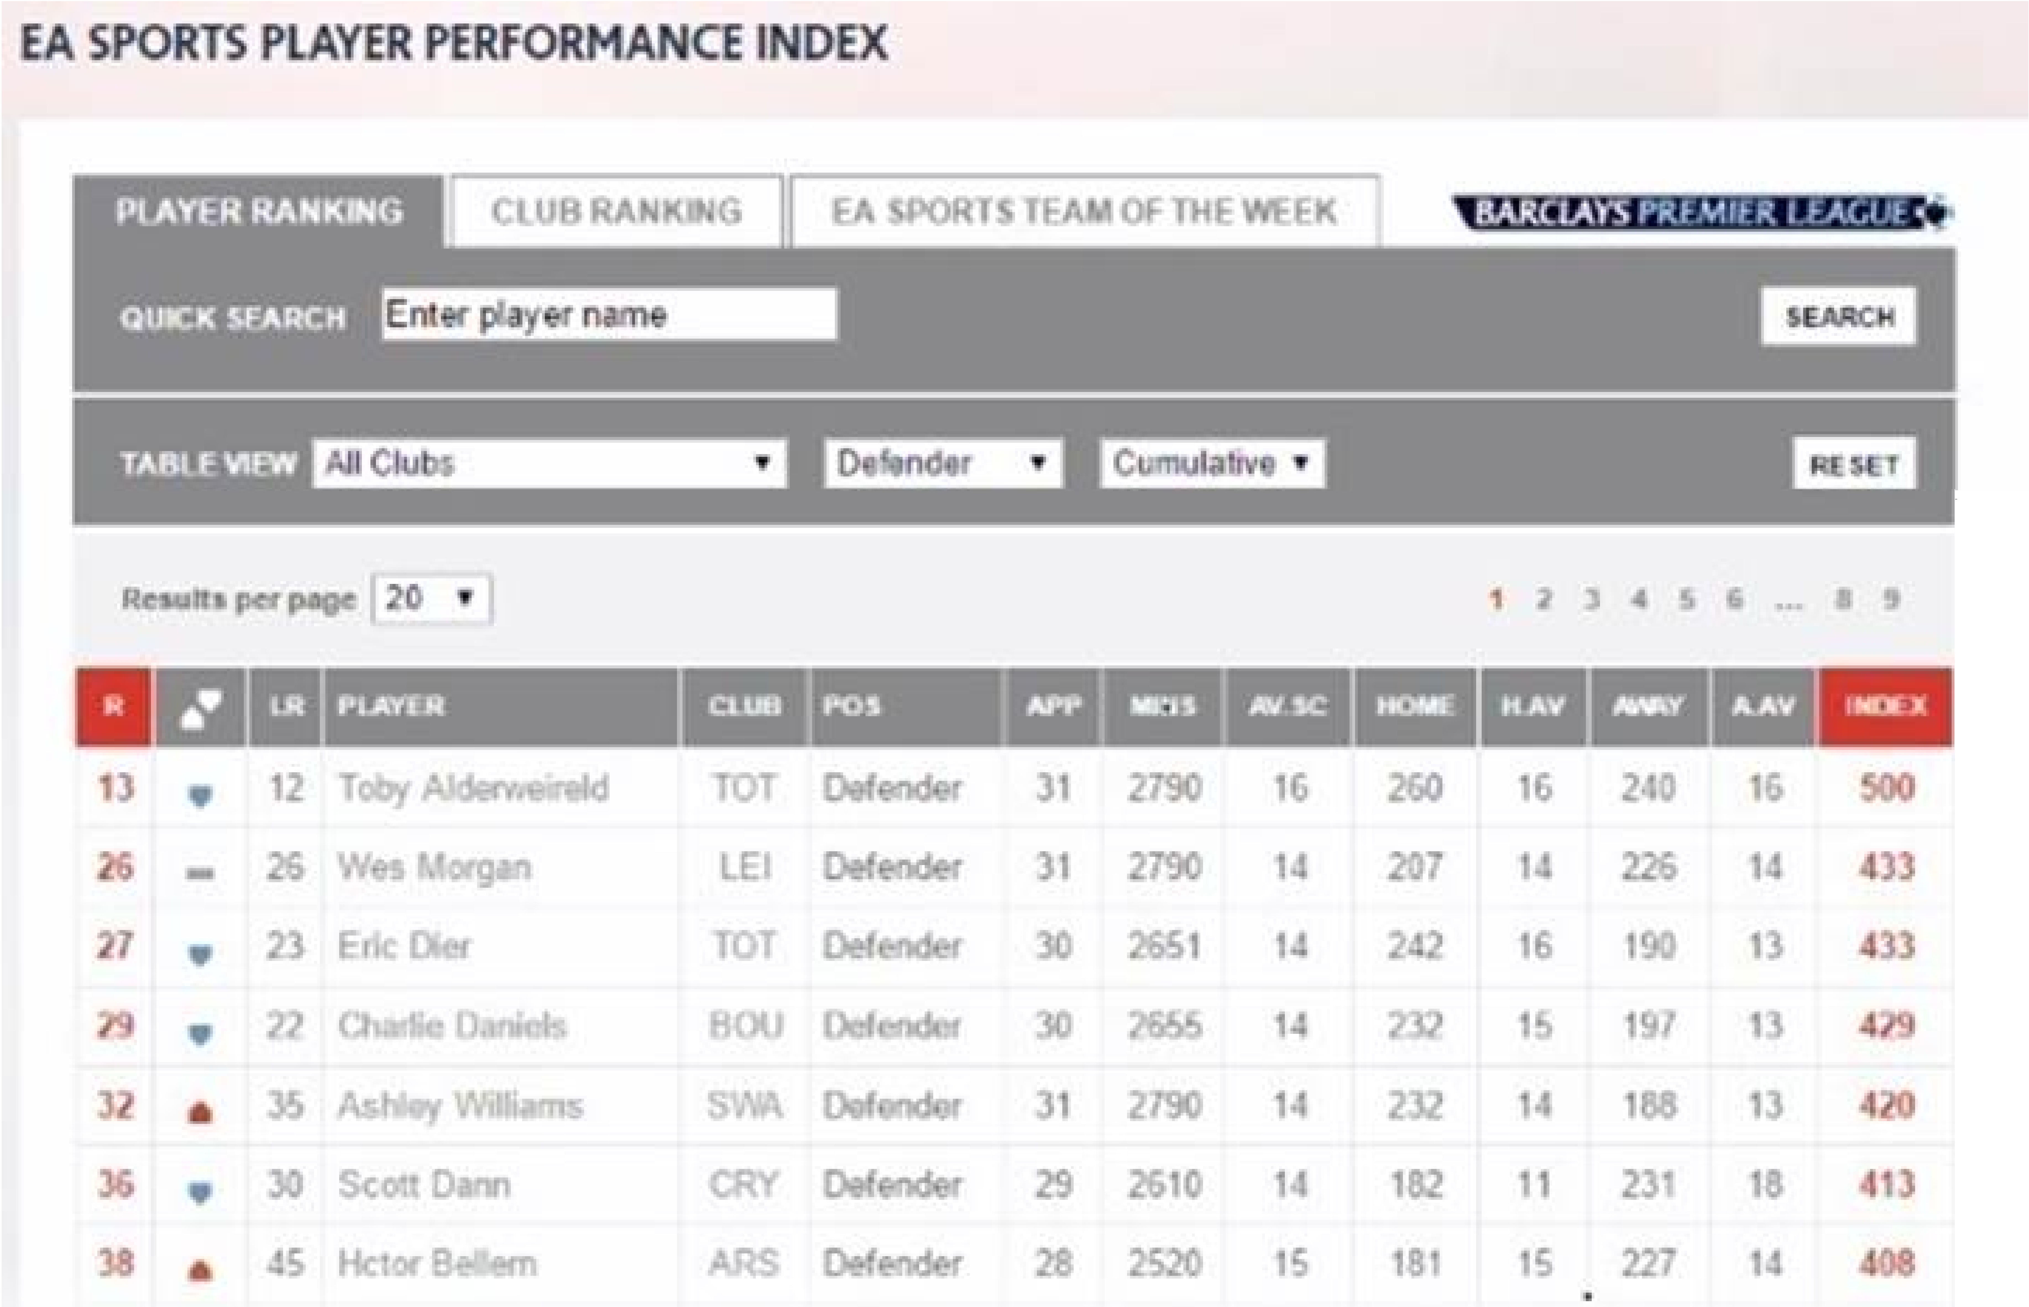

Slide 12
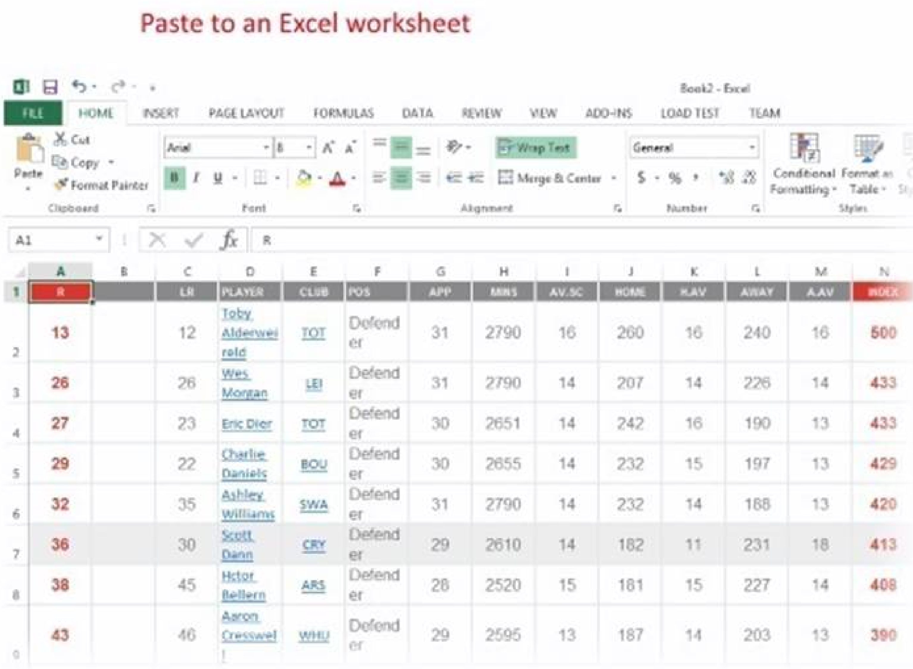

Slide 13
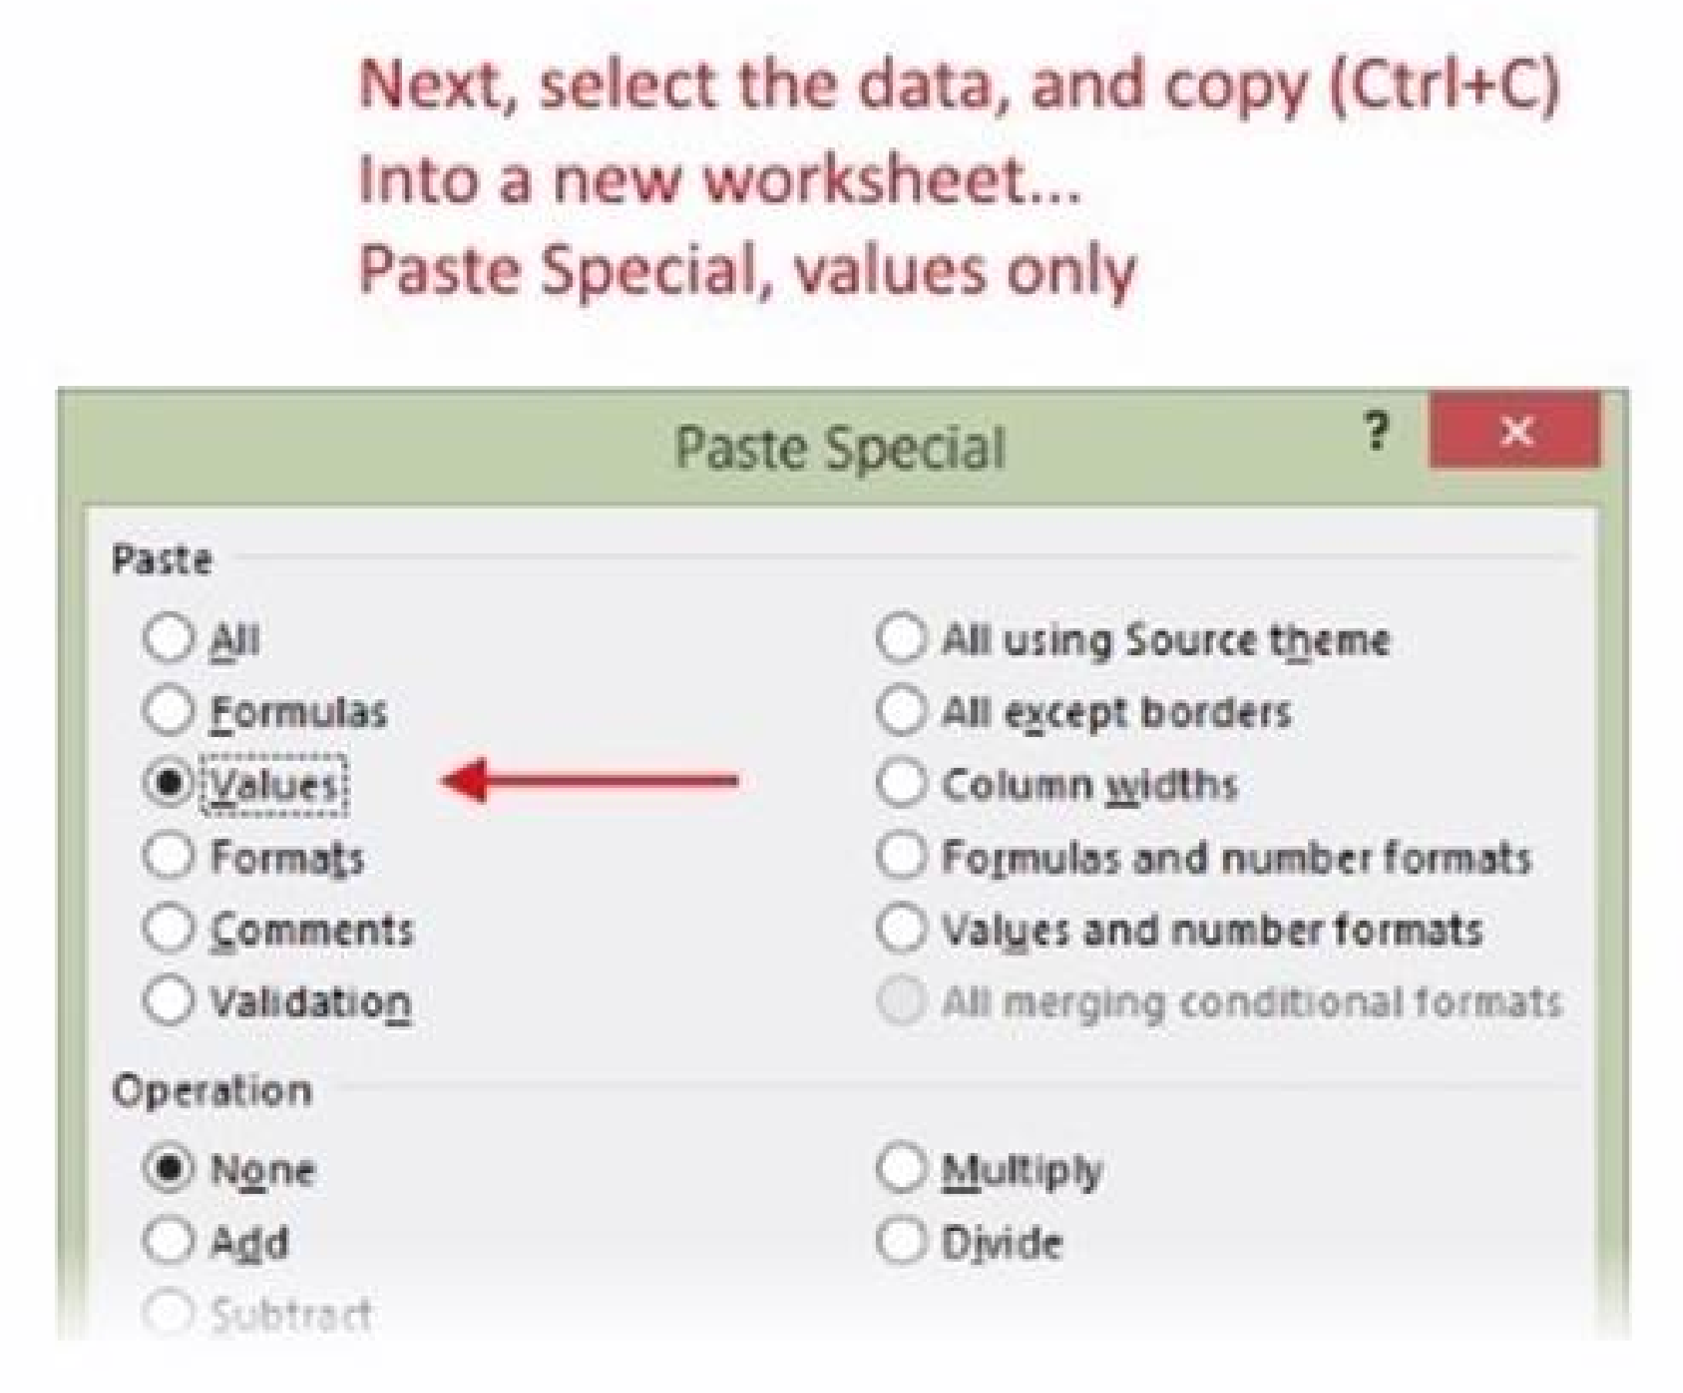

Slide 14
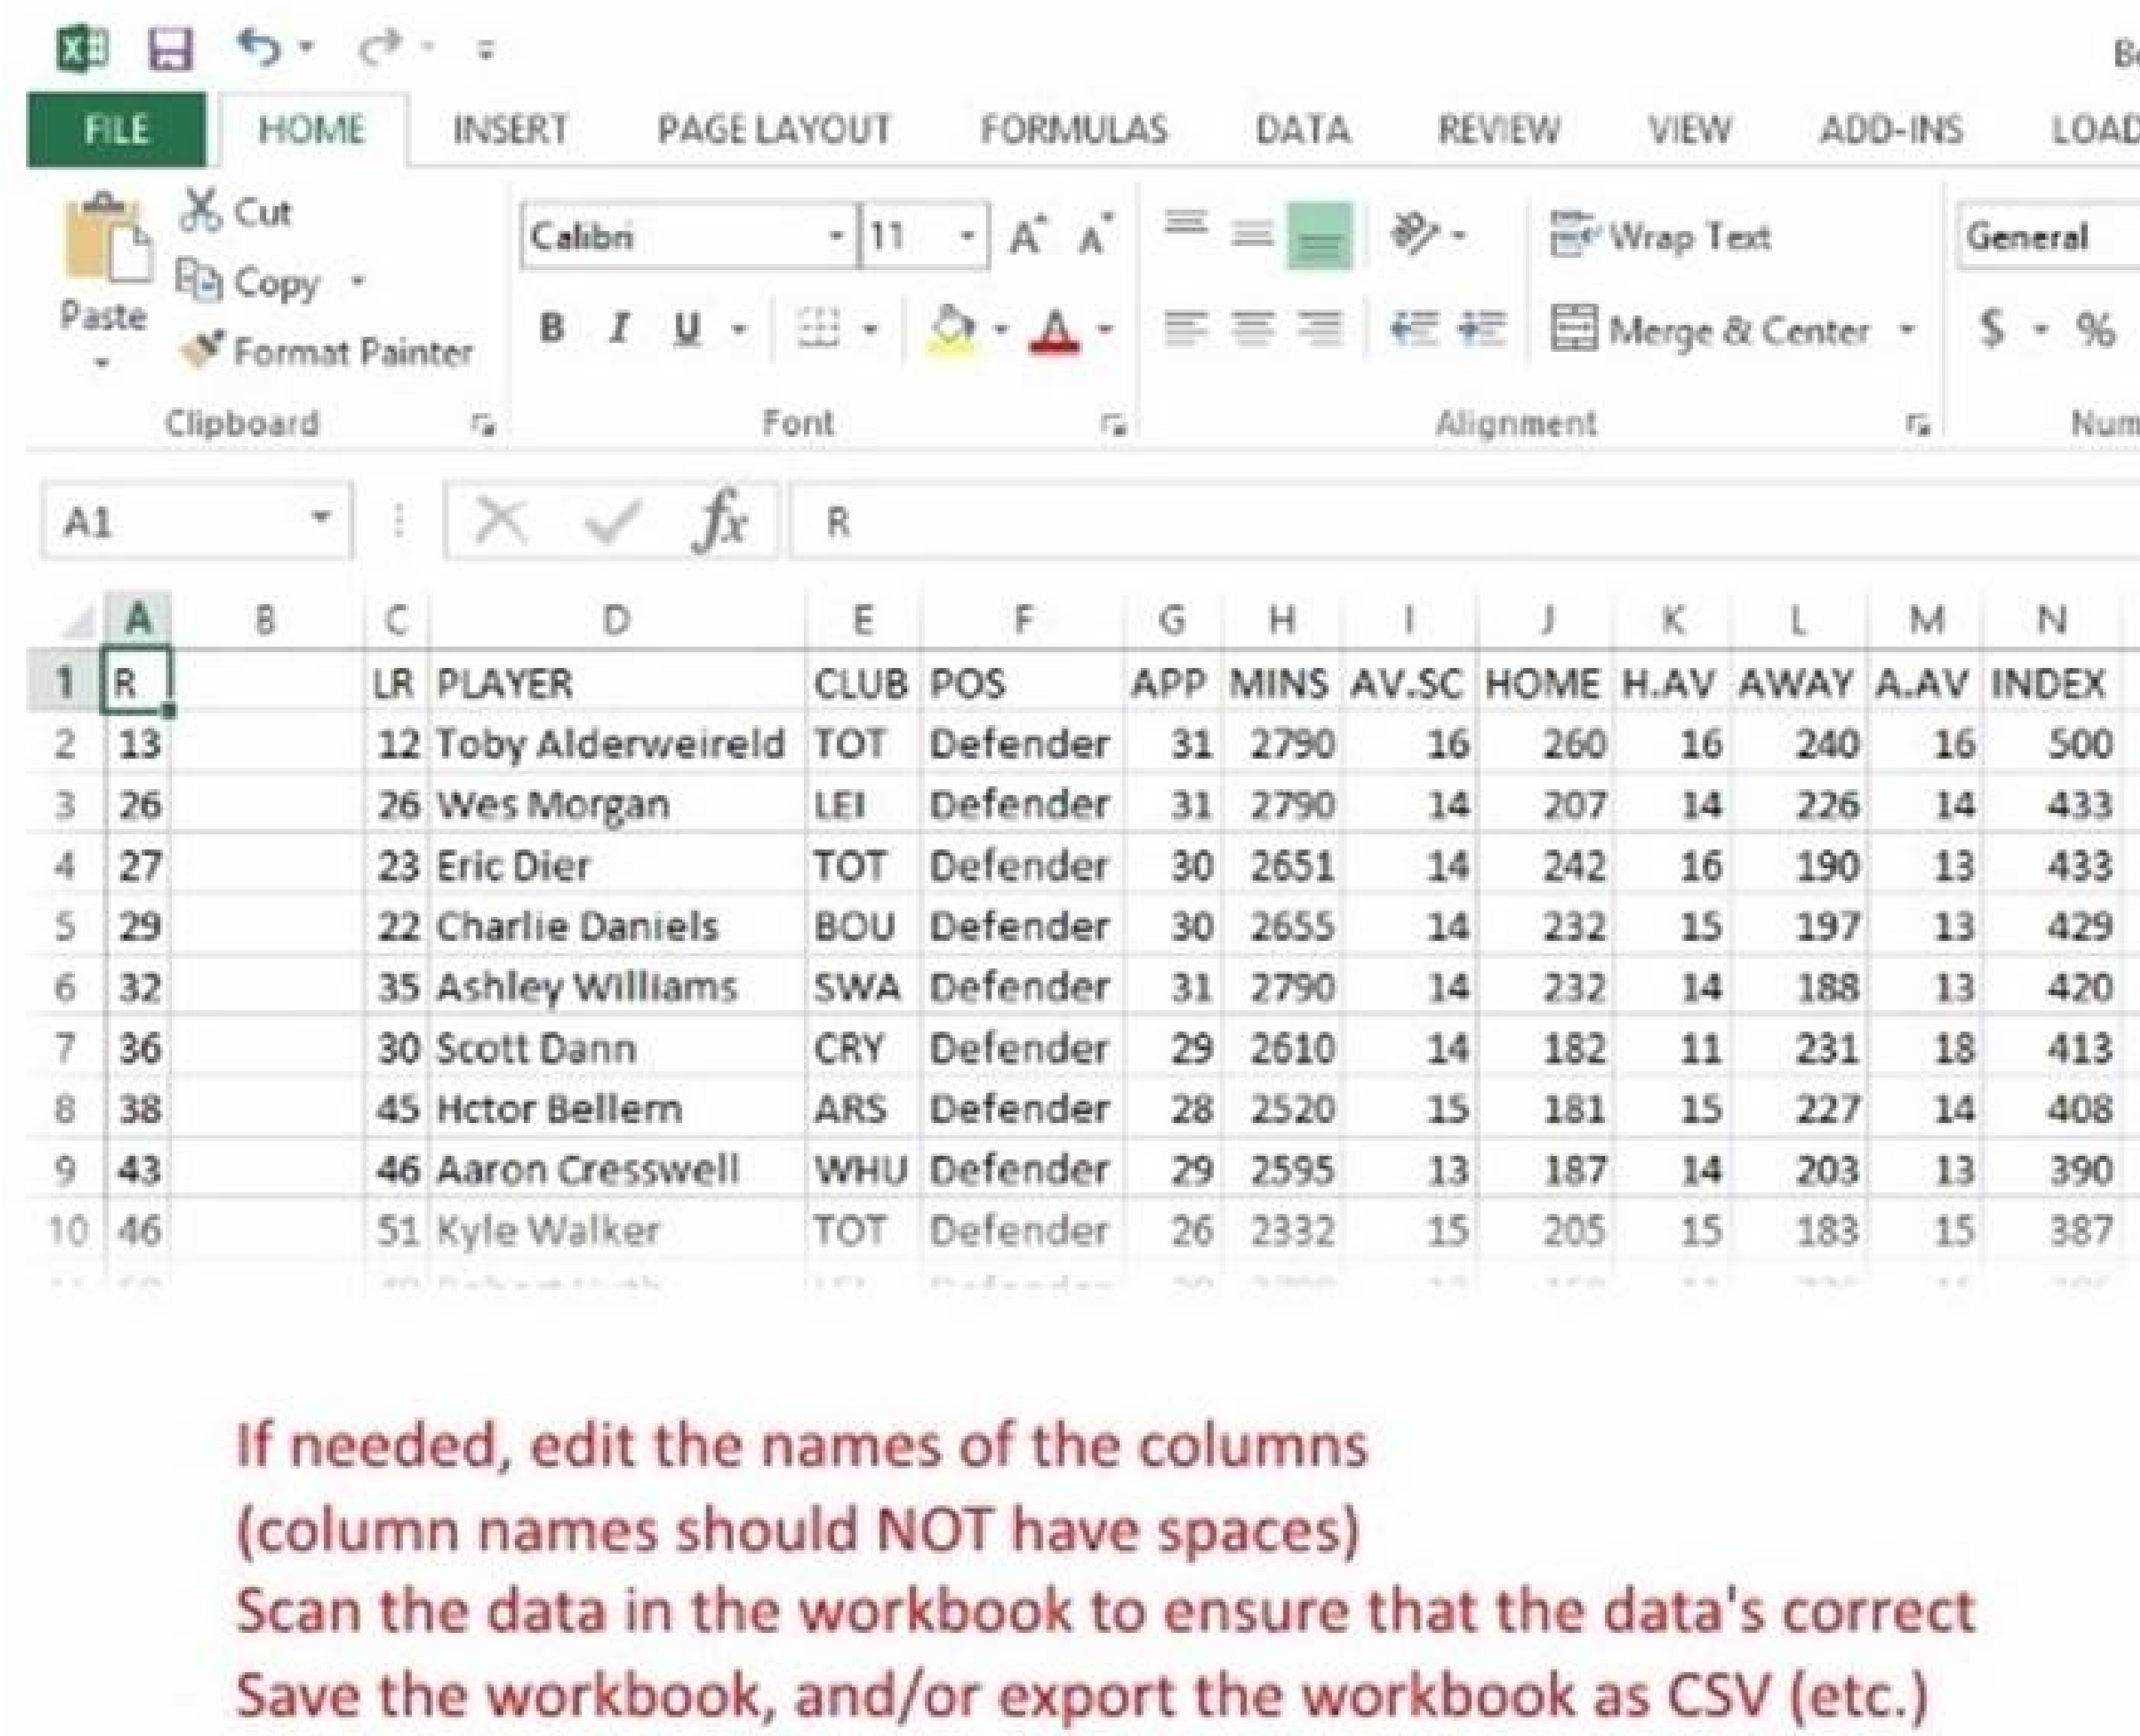

Slide 15
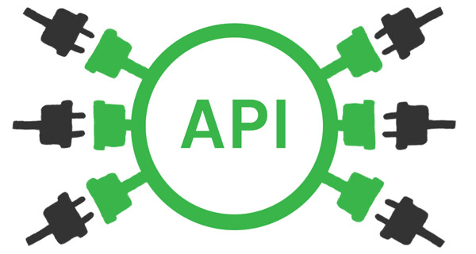
Maybe the data is in a Web API?
This can be a good thing – if you know how to programmatically access a web service.
The data is ready to be requested and used.
The “Node-Fetch” module will allow you to use the Fetch API.

Slide 16
What is the format of the source data?
Is the source data in a form that we can use?
Depending on its format, source data may be used with a small amount of conversion or transformation.
Some data formats need more work before they can be used and loaded.
In general, your goal should be to get or transform the data into a rows-and-columns format that makes it easier to understand, and then process on a row-by-row basis.

Slide 17
Location of the source data
Do we want the source data to be located within the project’s file system?
Sometimes, it can make sense to copy-paste a data source file into the project’s file system.
When you do this, your program can reference and use the file because you know exactly where it is.
Other times, you will need to allow the user (admin or developer) to select and use the data source at runtime.
When you do this, you will need some UI that has a file upload element, and logic that saves the file in the web app’s file system, so that it can be processed.

Slide 18


